Slide 1
NEtW191
Fundamentals of Information Technology and Networking
Desmoine Garrett
2/24/24

Slide 2
Introduction
Welcome to my NETW191 final class project. You will see as the project progresses, all the steps I have learned throughout the class here at DeVry University for the Fundamentals of Networking.

Slide 3
IPv4 Addressing
For this section of the project, I implemented an IPv4 addressing scheme to support a network. I assigned an IPv4 address to the SOHO Router virtual machine.

Slide 4
Preparation
First, I used the command: ip route | grep default to view the default gateway IP address.
Then I used the infosec virtual machine to change the IPv4 address on Mozilla Firefox from the default IP address: 192.168.1.1 to the new IP address: 192.168.105.0.

Slide 5
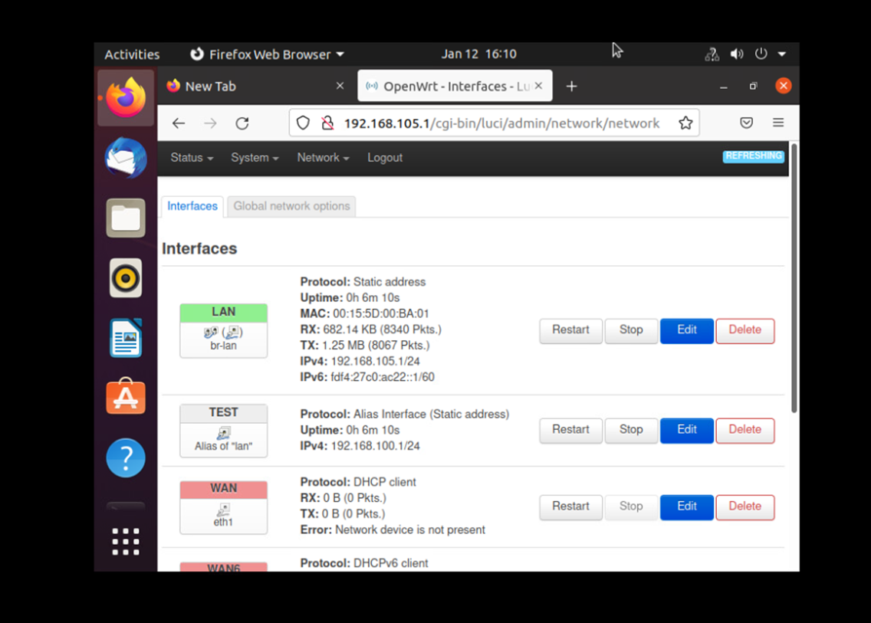
IPv4 Addressing Assignment
Next, I used the virtual computer to check and ensure the IP address matched the new IPv4 address on the command terminal.

Slide 6
Connectivity Testing
In this portion of the project, I tested the connectivity between two computers and the SOHO router. I used the ping utility to verify the network connectivity among the three virtual machines.

Slide 7
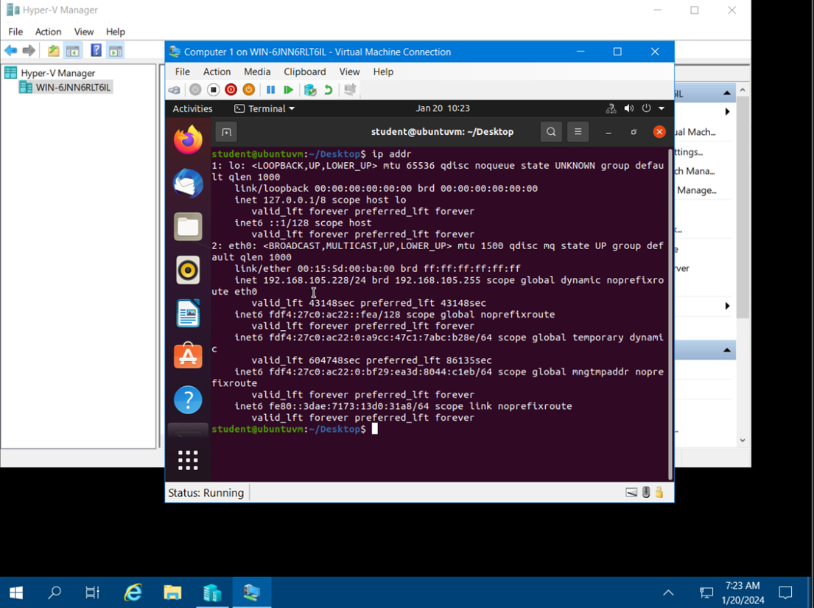
Dynamic IP Address Assignment
In this picture, it shows the IPv4 address of the Virtual Machine Computer 1.

Slide 8
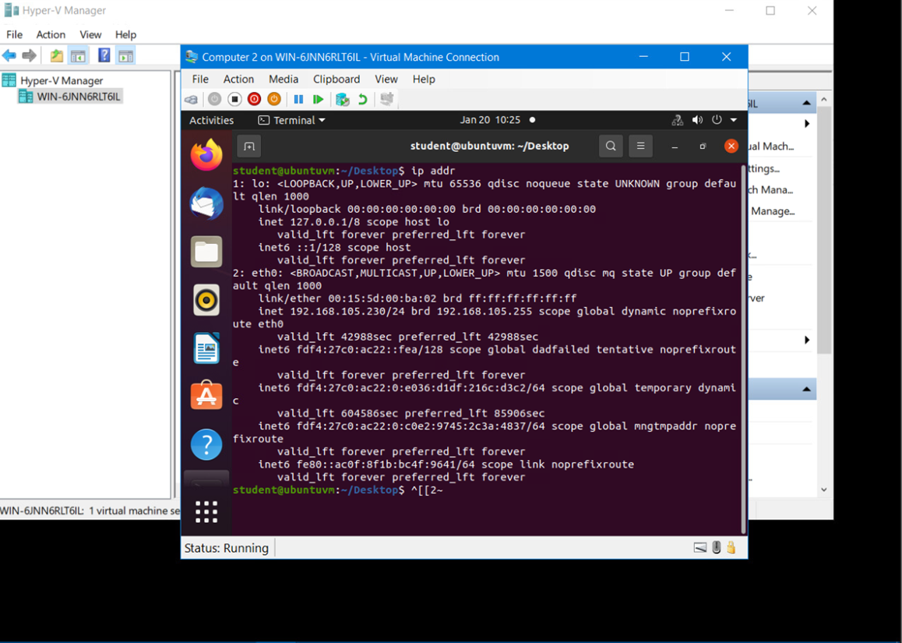
Dynamic IP Address Assignment
In this picture, it shows the IPv4 address of the Virtual Machine Computer 2.

Slide 9
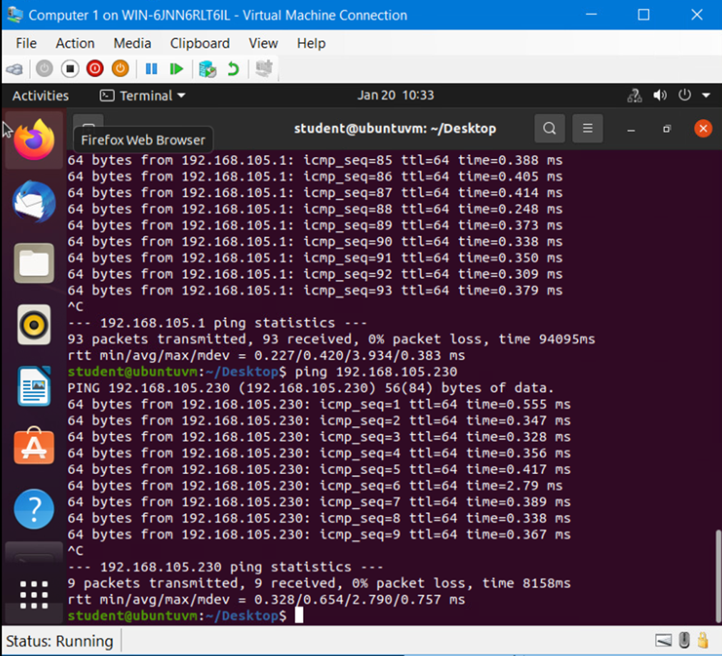
Connectivity Test
This is the connectivity test FROM the Computer 1 VM TO the SOHO Router Virtual Machine and the connectivity test FROM the Computer 1 Virtual Machine TO the Computer 2 Virtual Machine.

Slide 10
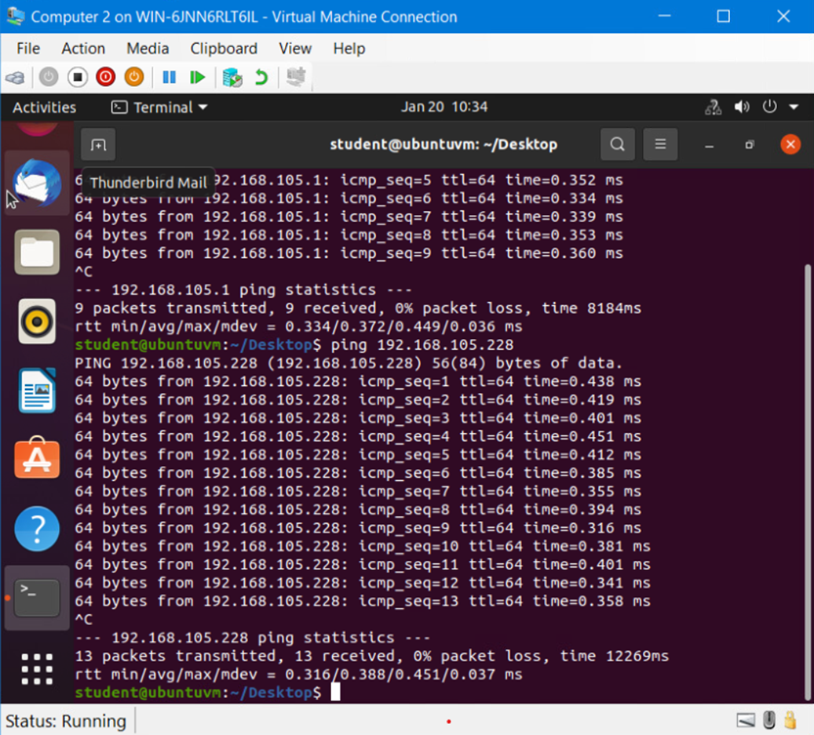
Connectivity Test
This is the connectivity test FROM the Computer 2 VM TO the SOHO Router Virtual Machine and the connectivity test FROM the Computer 2 Virtual Machine TO the Computer 1 Virtual Machine.

Slide 11
IP Subnetting and Loopback Interfaces
In this portion of the project, I started with a Class C network and divided its blocks of the IP address into smaller blocks. Then I configured two Loopback interfaces on a SOHO router, by using the IP addresses of the newly created subnets, to simulate two LAN Segments.

Slide 12
IP Subnetting
This table shows the following: Subnet Notation, Network Address, The First Usable Host Address, The Last Usable Host Address, and lastly The Broadcast Address.

Slide 13
Loopback Interfaces
This screenshot shows both Loopback1 and Loopback2 interfaces and their correct IPv4 addresses.

Slide 14
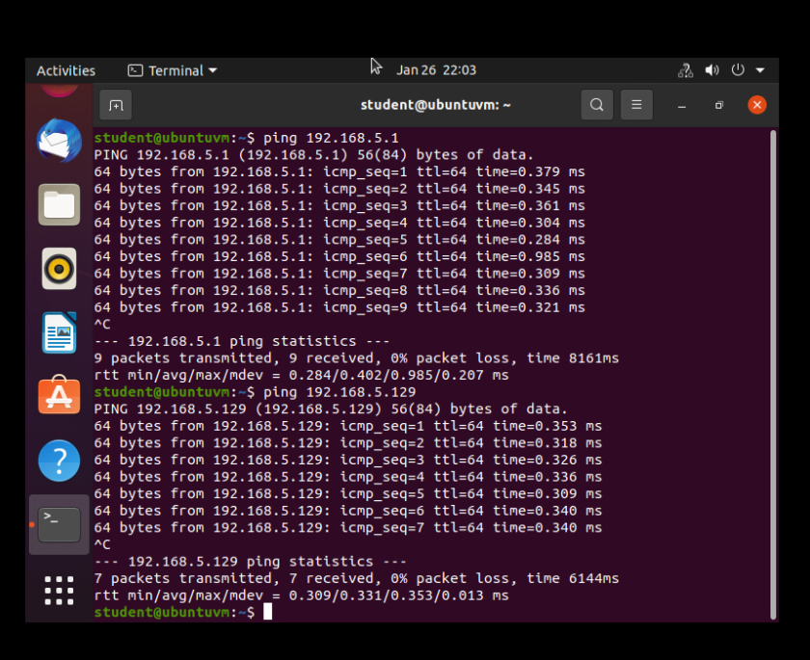
Connectivity Test
This screenshot shows two successful ping tests:
from the Computer 1 VM to the Loopback 1 interface
from the Computer 1 VM to the Loopback 2 interface

Slide 15
Visio Network Diagram
In this portion of the project, I learned how to use Microsoft Visio to create a network diagram that depicts the interconnection of Computer 1 Virtual Machine, Computer 2 Virtual Machine, and the SOHO Router Virtual Machine.

Slide 16
Visio Network Diagram
This diagram shows my illustration of the interconnection of the Computer 1 VM, the Computer 2 VM, and the SOHO Router VM along with proper IP addresses and labeling.

Slide 17
SOHO Wireless Network Security
For the final portion of this project, I will be using the TP-Link router emulator, and I will be using it to explore some of the router’s configurations that could be used to add protection to a SOHO wireless router. Then I answer questions based on the TP-Link Router Emulator.

Slide 18
SOHO Wireless Network Security 1 of 3
1. What are the factory default username and password of a TP-Link router? Why is it important to change the default username and password of a SOHO router?
Answer:
The default username and password for the TP-Link router is admin. It is important to change the default username and password to secure a new router.
2. To protect a SOHO wireless network with a few devices, which address management method provides more control, configuring the device IP addresses manually (static IP) or using a DHCP server (dynamic IP)? Why?
Answer:
Configuring the device IP addresses manually (static IP) gives the network administrator direct control over the IP address for each device that is connected to the SOHO router.

Slide 19
SOHO Wireless Network Security 2 of 3
3. What does MAC filtering do? If needed, when would you use deny filtering rules and when would you use allow filtering rules? What happens to devices that want to connect, if the “Allow the stations specified by any enabled entries in the list to access” function is enabled but there are no entries in the list?
Answer:
MAC filtering adds an extra layer of security that checks the device’s MAC address against a list of approved addresses. When the “Allow the stations specified by any enabled entries in the list to access” is enabled and there are no entries on the list, no devices will be able to connect. The network then becomes restricted until a valid MAC address, or addresses are added.
4. What wireless security settings are displayed on the Wireless Security page? Which one is recommended by the vendor? Why?
Answer:
The wireless security settings that are displayed on the page are WPA/WPA2-Personal with the WPA2-PSK version, in an AES encryption. It is recommended because it is the most secure option, and it uses the latest encryption technology.

Slide 20
SOHO Wireless Network Security 3 of 3
5. Among the configurations you explored in this module, which one is a true security function? Why?
Answer:
The WPA2-PSK in AES encryption is a true security function. It is a true security function because it gives the admin the ability to protect their wireless networks from unauthorized access. Also, the AES encryption offers better built-in security features that help prevent attacks.
6. What would you do to protect your wireless network at home? Why?
Answer:
I always change my Wi-Fi username and password every 3 or so months. I do this so that way it will prevent unauthorized users and it also helps maintain which devices I have on my network, so I can monitor my bandwidth and improve my network’s performance.

Slide 21
Gained Career Skills
In this project, I gain skills by:
Learning how to ping IP address and check the IPv4 Address.
I learn how to test the connectivity between the 2 Virtual Machine Computers and the SOHO Router.
I learned how to divide the blocks of a Class C Network into smaller blocks and Then I configured two Loopback interfaces on a SOHO router, by using the IP addresses of the newly created subnets, to simulate two LAN Segments.
Then I downloaded Microsoft Visio and learned how to create diagrams of the network I created for the SOHO router and the 2 Virtual Machine Computers.
Lastly, I used the emulator to see how to configure a SOHO Wireless Router Network Security.

Slide 22
Conclusion
Thank you for viewing my NETW191 final project. In this project, you will see how we covered networking fundamentals by designing and developing a process for building a network on a virtual machine using SOHO router configurations, subnetting, connectivity testing, network documentation, and SOHO wireless network security.

Slide 23
References
TP-Link Emulators – TP-Link Emulators | TP-Link
Router Passwords- https://www.routerpasswords.com/
DeVry University Course Project Deliverable
NETW191 Live Class 2-6
InfoSec learning lab instructions.

Slide 24
Thank You!
Desmoine Garrett
2/24/2024

